Slide 1

Analysis of the Data surrounding Udemy Courses with regard to Subscription Level, Rating, Review and Price

Slide 2
Analysis of the Udemy Courses Data with regard to Subscription Level, Ratings, Review and Price
I approached the analysis of this data by looking at the parameters of the data set and then combined them with each other to see if I could arrive at any insights that could reveal some useful information about the data.
The analysis was derived by considering the following parameters as the lead parameter and combining them with the other parameters:
Number of Subscribers - Price Detail Amount
Number of Published Lectures - Ratings
Number of Reviews

Slide 3
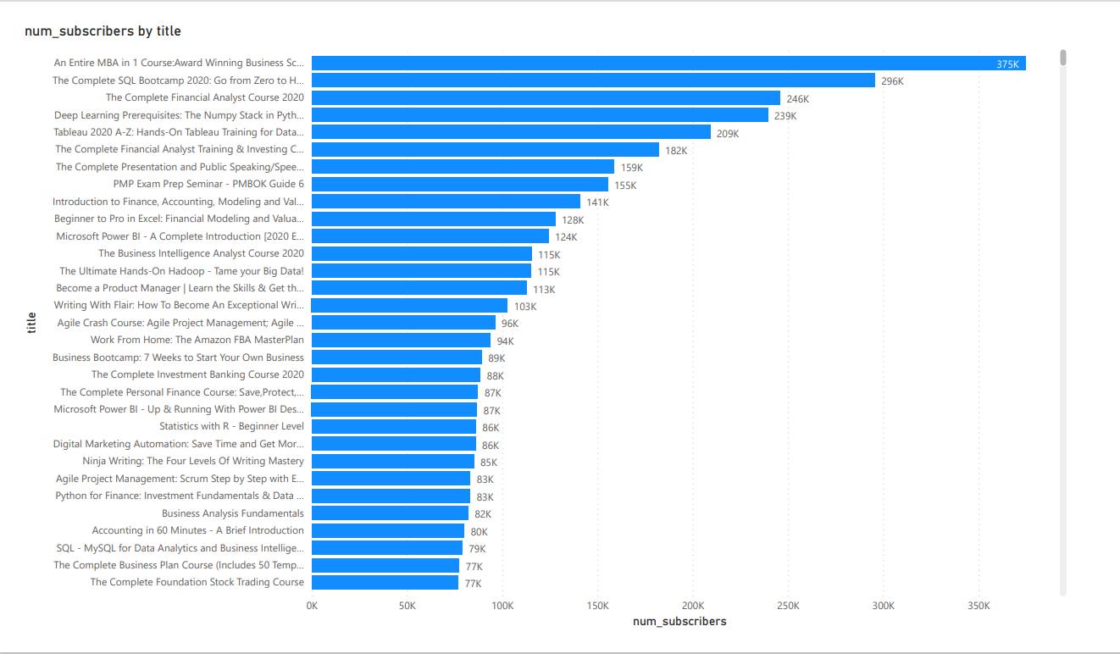
Analysis of the Number of Subscribers

Slide 4
Analysis of the Number of Subscribers continued
I plotted the Number of Subscribers versus the Course Title and found the following information:
The highest number of subscribers is for the MBA Course with 375000 Subscribers. The rest of the top 10 Course Titles by the Number of Subscribers show that these courses are geared towards the skill set required by a Data/Financial Analyst comprising of Programming Skills, Data Analysis Software Applications and Stand-up Presentation Skills.
For the remainder of the Top 30 Course Titles, they consist of courses to Store and Process Large Sets, Statistical Analysis and Data Analysis using Programming Languages such as R, SQL and Python.
There is also a popular interest in developing a Work from Home Business with Amazon and to compliment this courses in Digital Marketing and Accounting were also popular.
In addition to this, courses in Personal Finance, Investment Banking and Stock Trading also featured in the lower half of the Top 30. The Data Analytics Software Applications and programming Languages can also link into this subject area as well.

Slide 5
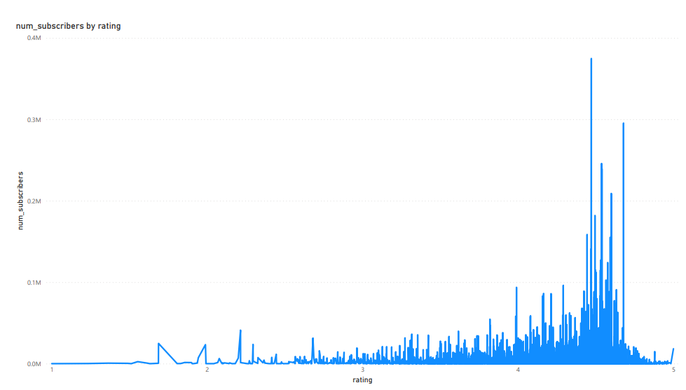
Analysis of the Number of Subscribers continued
As we can see the Number of Subscribers increase as the Ratings increase, although within each rating level the number of subscribers oscillates. This diagram needs to be subdivided to show the data that occurs within each Ratings Level. Please the diagrams below that display this.

Slide 6
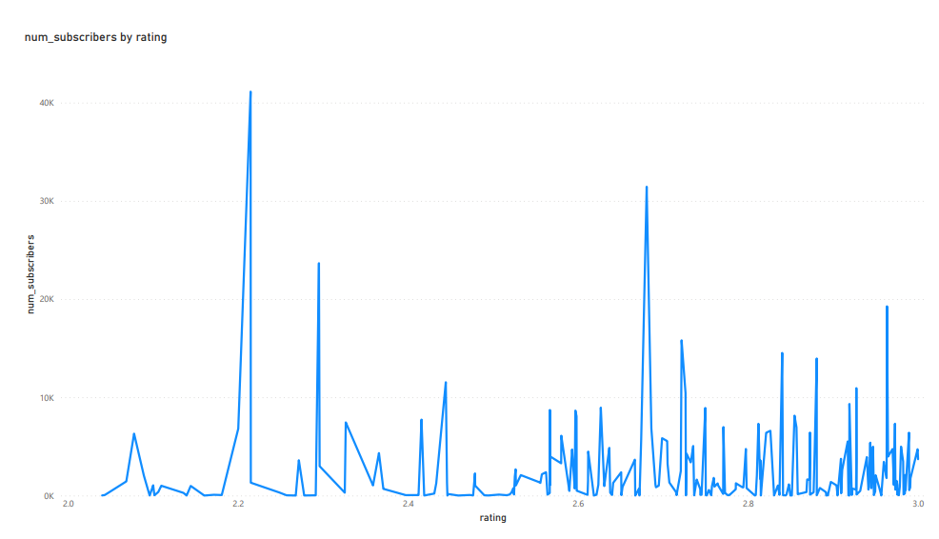
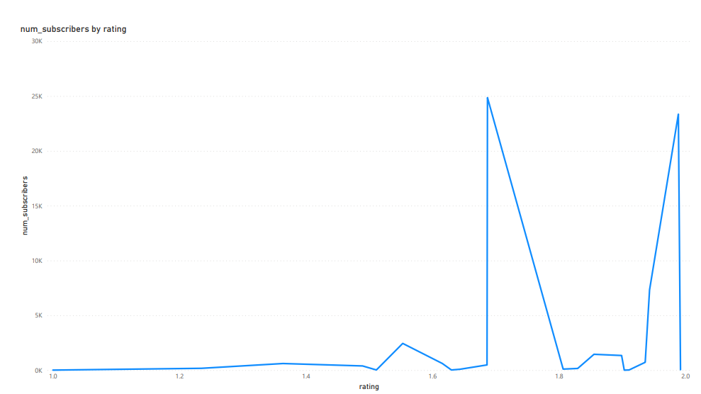
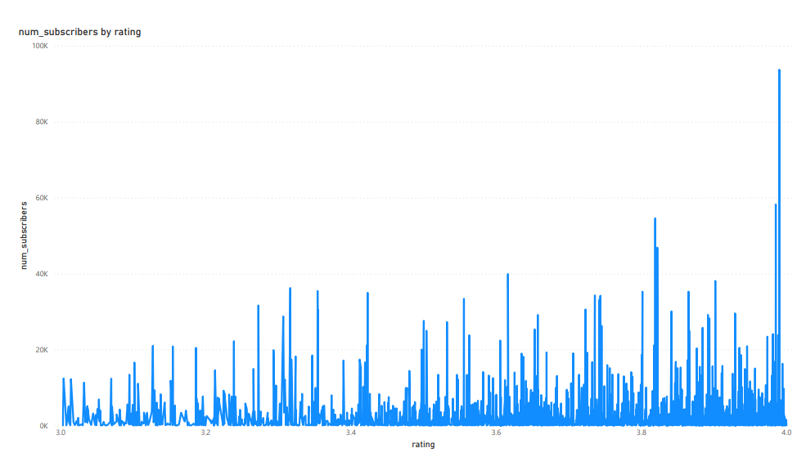
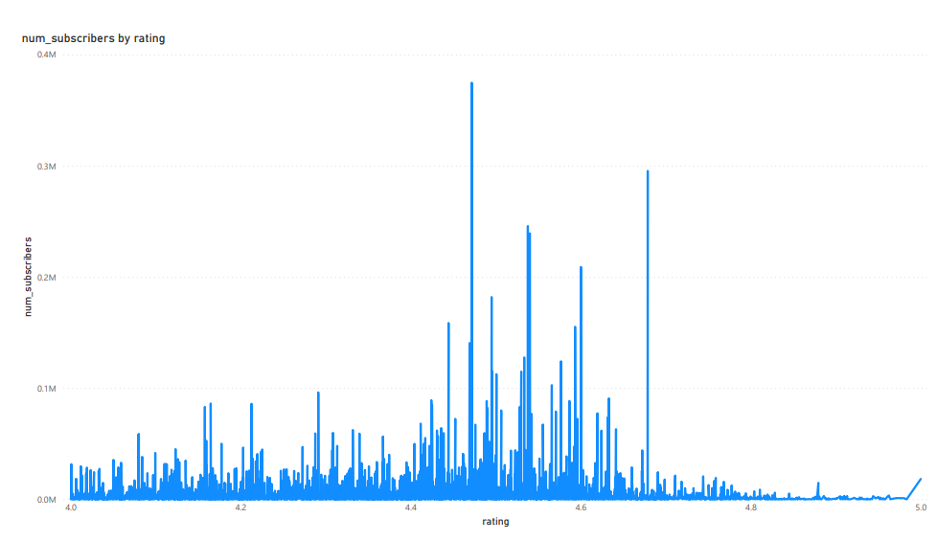
Analysis of the Number of Subscribers continued

Slide 7
Analysis of the Number of Subscribers continued
For ratings between 1 and 2 the number of subscribers is very low up until a rating of 1.69 where the number of subscribers reaches just under 25000 and then it oscillates briefly until the number of subscribers rises back up at a rating of 1.99.
For ratings between 2 and 3 there is a lot of oscillation within this range with 7 major peaks, three of which have the number of subscribers 41120, 23659 and 31442 relating to a rating of 2.21, 2.30 and 2.68.
For ratings between 3 and 4 the number of subscribers across this range seems to be divided into sections, which start and end with a peak and in between the number of subscribers oscillates, whereby one section leads directly onto another.
If you compare the Number of Subscribers against their respective Ratings, I noticed that for ratings up to 4, there is a low level of subscribers. Once the Ratings reached 4, the Number of Subscribers started to rise and are their highest here than anywhere else in the data set. Once the ratings reach 4.69, the number of subscribers starts to fall significantly and stays around this level until the end of the data set. This shows that courses that have received a rating from 4.69 to 5 have the fewest number of subscribers.

Slide 8
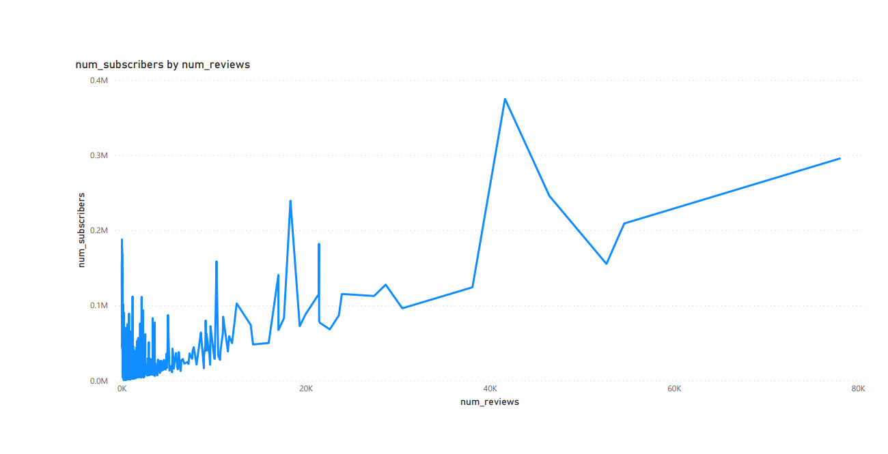
Analysis of the Number of Subscribers continued
As you can see from the Number of Subscribers vs the Number of Reviews, the general trend is that the more reviews you receive the more Subscribers you have. However, this is not always the case as is shown in the areas of the data, particularly at the start, where the number of reviews is low but the number of subscribers is reasonably high. This is shown in the data where a lot of oscillation occurs.

Slide 9
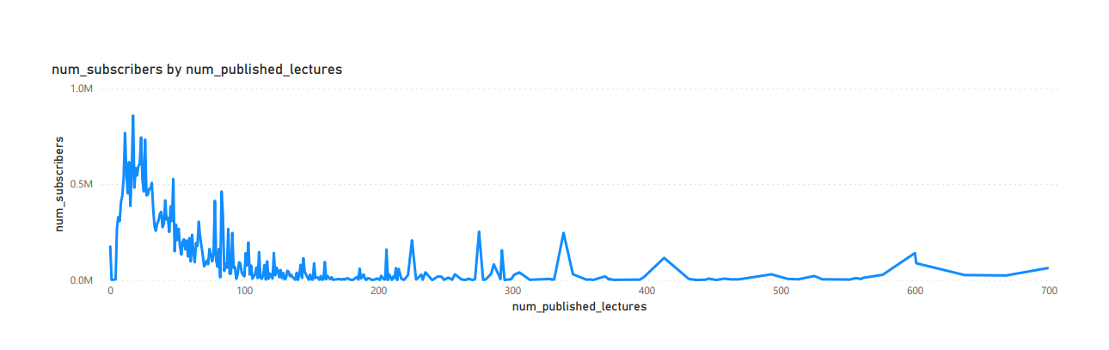
Analysis of the Number of Subscribers continued
As you can see from the Line Graph of the Number of Subscribers vs the Number of Published Lectures, the general trend is that the more there are of published lectures the less there are of subscribers, as people can view the published lectures without subscribing. We can also see that between 0 and 100 published lectures, occurs the highest number of subscribers as more people will need to attend a course if the lectures are not readily available.

Slide 10
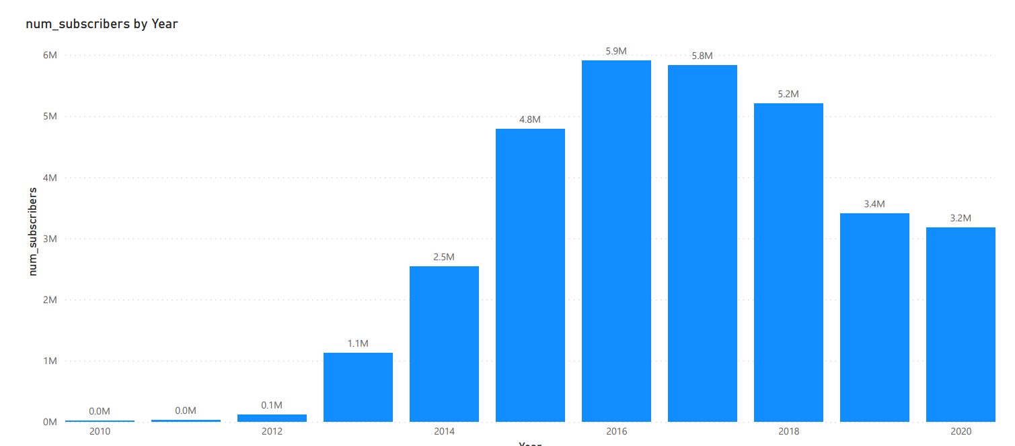
Analysis of the Number of Subscribers Per Year
As we can see from the Bar Chart, the Number of Subscribers increases steadily from 2010 to 2016 from 0 to 5.9 Million and then decreases steadily in consecutive years until 2020.

Slide 11
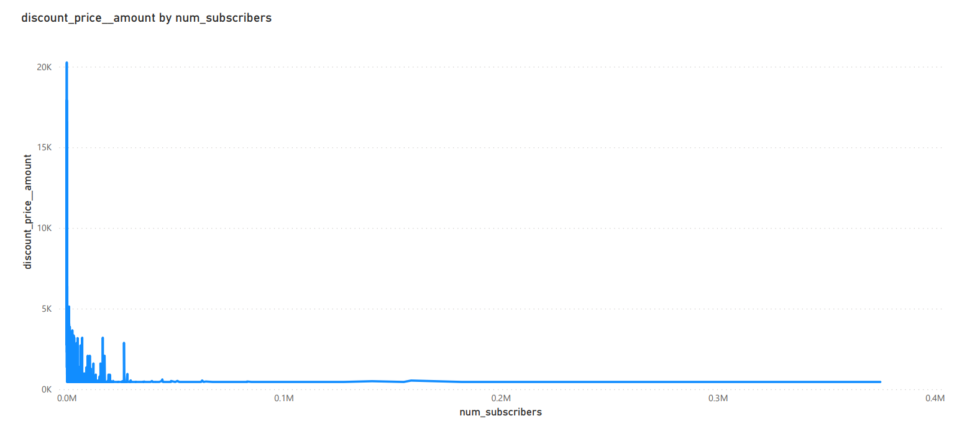
Analysis of the Number of Subscribers vs Discount Price Amount
The data shows that courses that have a low subscription level have the highest Discount Price Amount. This makes good business sense as non profitable courses can be assigned discounted prices as opposed to courses at a higher subscription level that are not subsidised and are therefore more profitable.

Slide 12
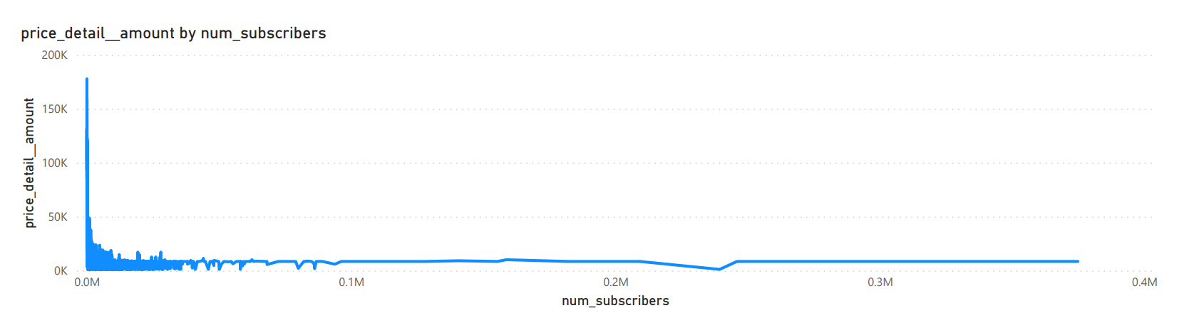
Analysis of Price Detail Amount vs Number of Subscribers
The data shows that courses at a lower subscription level carry high prices as opposed to courses at a higher subscription level that are assigned a more competitive price to make them more profitable in the long run.

Slide 13
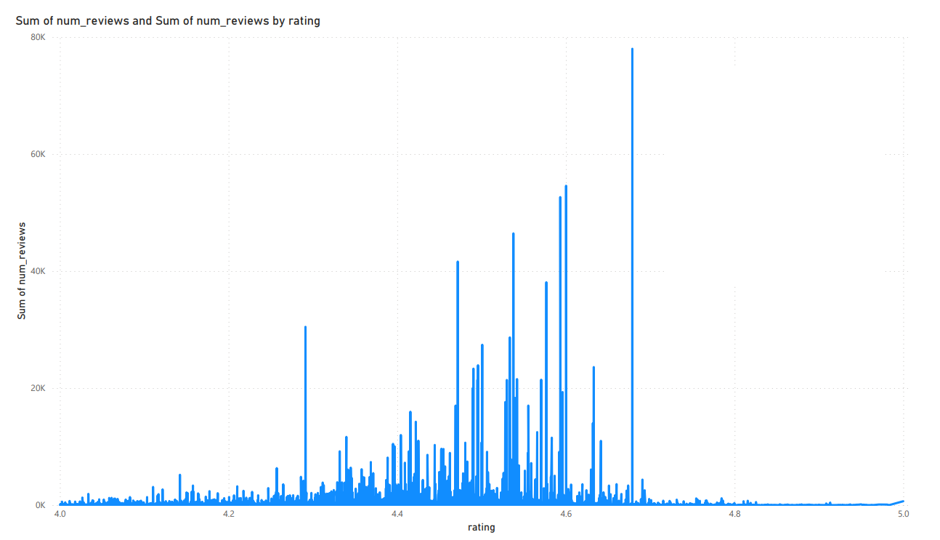
Analysis of the Number of Reviews
As the Ratings reach 4, the number of reviews starts to increase and oscillates from one ratings to the next within the 4-5 ratings range. Therefore, the higher the rating the more likelihood of the number of reviews being high.

Slide 14
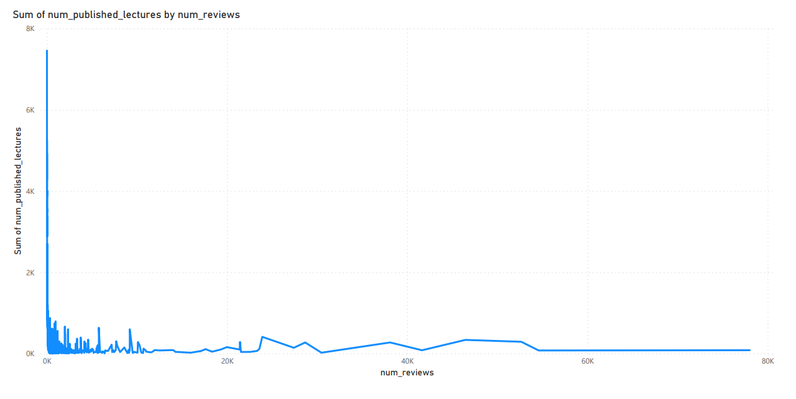
Analysis of the Reviews continued
When there are more published lectures they occur when there are the least amount of reviews. This shows that people review courses more than published lectures, as published lectures are treated as more of an information source.

Slide 15
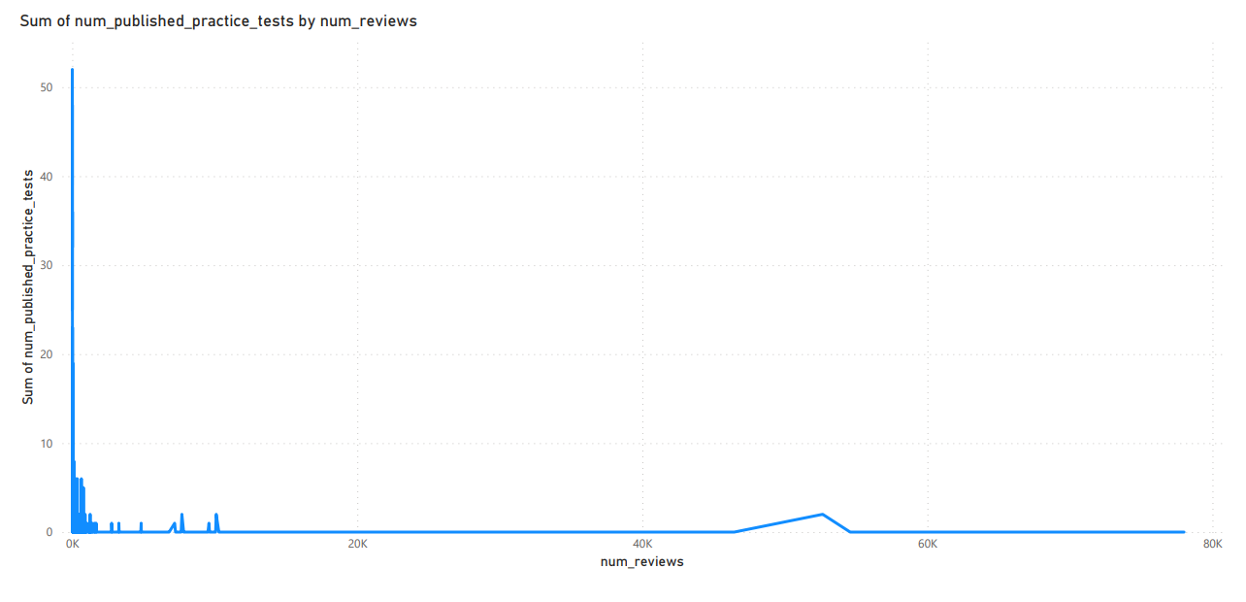
Analysis of the Number of Reviews continued
The highest number of published practice tests occurs when there are the smallest amount of reviews. When clients have to self serve by using published lectures and practice tests they tend not to review this

Slide 16
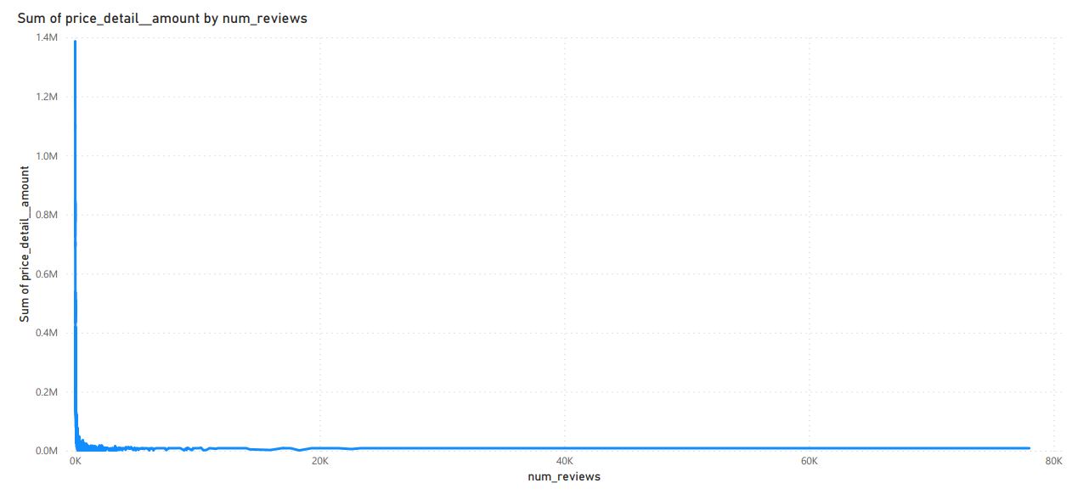
Analysis of the Number of Reviews continued
As we can see, the higher the price detail amount the fewer the number of reviews. This shows that higher price does not prompt consumers to provide a review.

Slide 17
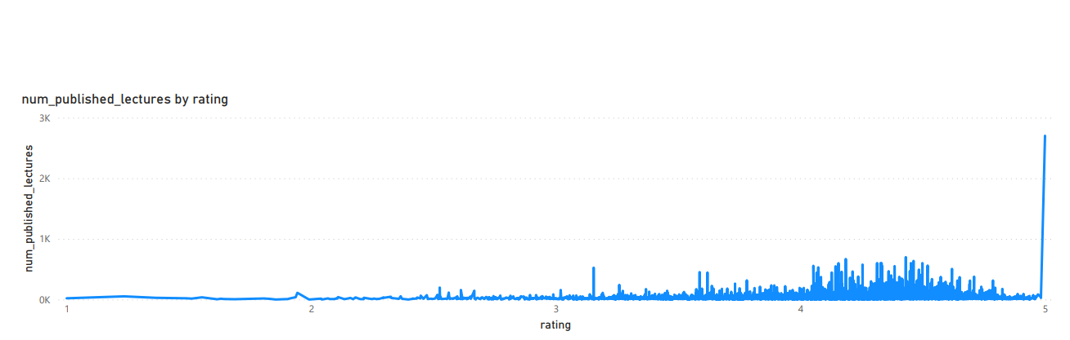
Analysis of Rating
As we can see, on the whole, the higher the rating is the higher the number of published lectures.

Slide 18
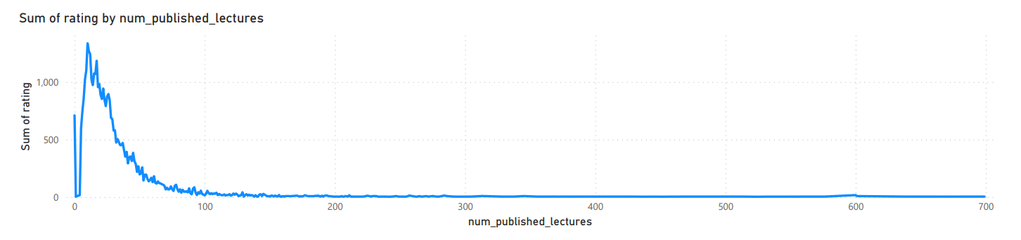
Analysis of the Ratings continued
When analysing the Ratings vs the Number of Published Lectures, it is clear that as the ratings decrease the number of published lectures decrease. When the ratings are at their lowest, this will have no bearing on the number of published lectures.

Slide 19
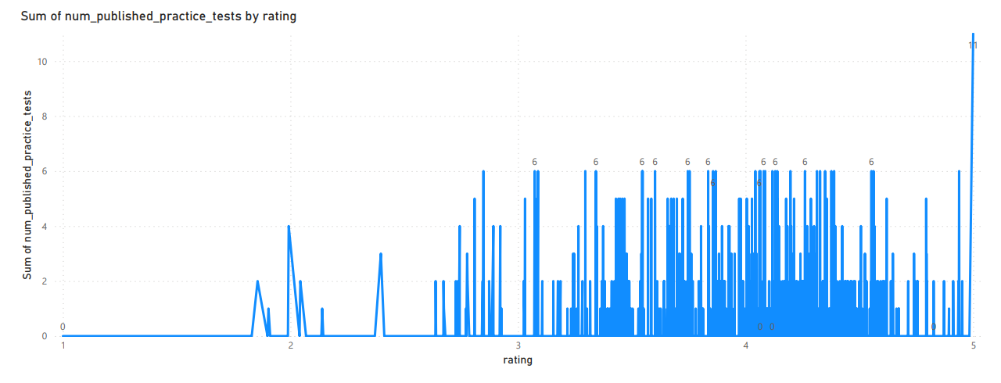
Analysis of Ratings continued
There is a interesting insight here when plotting the Number of Published Practice Tests vs the Rating, which is that there seems to be an optimum number of practice tests of 6 for ratings between 3 and 5.

Slide 20
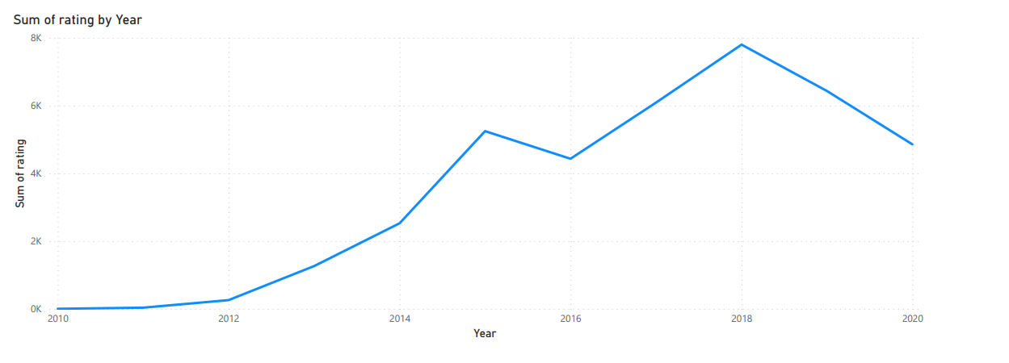
Analysis of Ratings continued

Slide 21
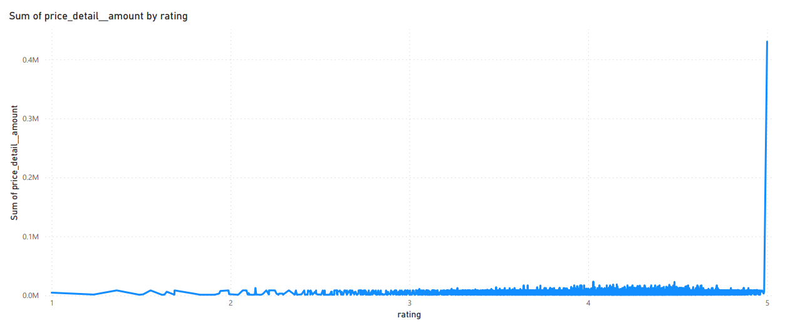
Analysis of Ratings continued
By analysing the Price Detail Amount vs Rating, I have noticed that as you move from rating 2.59 to 4.98 the Price Detail Amount remains practically consistent as there seems to be little movement in the Price Detail Amount across this range.

Slide 22
Conclusions
Consumers are buying courses to enable themselves to run their own businesses and develop another income stream. This also includes skills to analyse business data to equip themselves to make well informed business decisions.
With regard to the Number of Reviews, the more reviews you receive the more subscribers you have, but throughout the data set there are exceptions to this conclusion.
The more there are of published lectures, the less there are of subscribers as published lectures are readily available without subscribing, as opposed to attending a course where a subscription is required.
The data shows that courses that have a low subscription level have the highest Discount Price Amount. This makes good business sense as non profitable courses can be assigned discounted prices as opposed to courses at a higher subscription level that are not subsidised and are therefore more profitable.
Courses at lower subscription levels carry high prices as opposed to courses at a higher subscription level that are assigned a more competitive price to make them more profitable in the long run.
The higher the rating, the more the likelihood of the number of review being high.
Published Lectures/Practice Tests are treated more as an information source and are subsequently less reviewed.

Slide 23
Conclusions continued
The higher the rating, the higher the number of published lectures.
There is an optimum number of 6 published practice tests for ratings in the range 3.07-4.51.
- There is very little movement in the price detail amount when the rating is between 2.59 and 4.98.

